Slide 1

Instructor Notes
Ensure you update your contact information on the Title slide
This class is a combination of Lecture, Demo and Lab
Class duration is expected to be approximately 4 hours
All Demos and Labs are described in the slide Notes
File Student Modeling_PreClass.pbix does not have all DAX applied, and will be used by the students in Labs.
Save a copy of this file to add DAX and perform demos during class. It is easier to save a copy as in one demo, you will need to show “before and after” file sizes
File Instructor Complete Modeling.PBIX has all complete DAX and relationships applied. Use this file for Demos.
Answers to the Knowledge Checks can be found in the Appendix
Both PBIX files have a FullPath parameter which can be adjusted to the location of the source data file VanArsdel_Actuals.xlsx
Download and install Power BI Desktop:
Download and install Microsoft Power BI Desktop from: http://www.microsoft.com/en-us/download/details.aspx?id=45331
Version: 20170428
Notes:
Changes:
Removed all M and C notations for measures and calculated columns in the formulas and notes
Replaced “Advanced DAX” with “data modeling”

Slide 2

Instructor name
Title
Email
Version: March_2017
Notes:
Purpose of this presentation: Power BI Modelling
Target audience: Analysts, Report Builders

Slide 3
Prerequisites and Setup Steps
Internet connectivity: You must be connected to the internet
At minimum, a computer with 2-cores and 4GB RAM running one of the following version of Windows: Windows 7,
Windows 8, (64-bit preferred), Windows 8.1 or Windows 10 or Windows Server 2008 R2 or Windows Server 2012/R2
Microsoft Power BI Desktop requires Internet Explorer 9 or greater
Verify if you have 32bit or 64bit operating system to decide if you need to install the 32bit or 64bit applications.
Search for computer on your PC, right click properties for your computer
You will be able to identify if your operating system is 64 or 32 bit based on “system type” as shown below
Download and install Power BI Desktop: Download and install Microsoft Power BI Desktop from http://www.microsoft.com/en-us/download/details.aspx?id=45331. Optionally, you can also install the Power BI Desktop tool from the Power BI Desktop Install folder on the flash drive that will be provided on the day of the session. Please choose appropriate 64-bit or 32-bit version depending on your platform. Microsoft Power BI Desktop is available for 32-bit (x86) and 64-bit (x64) platforms
Download Class Files:
Copy Files from your USB to C:\Power BI_Adv_Model\ (Please return the USBs)
NOTE: This lab is using real anonymized data and is provided by ObviEnce LLC. Visit their site to learn about their services: www.obvience.com .
This data is property of ObviEnce LLC and has been shared for the purpose of demonstrating PowerBI functionality with industry sample data. Any uses of this data must include this attribution to ObviEnce LLC.
Notes:
If you choose to put your class files in a different folder than noted on the slide, update the path in the FullPath parameter.

Slide 4



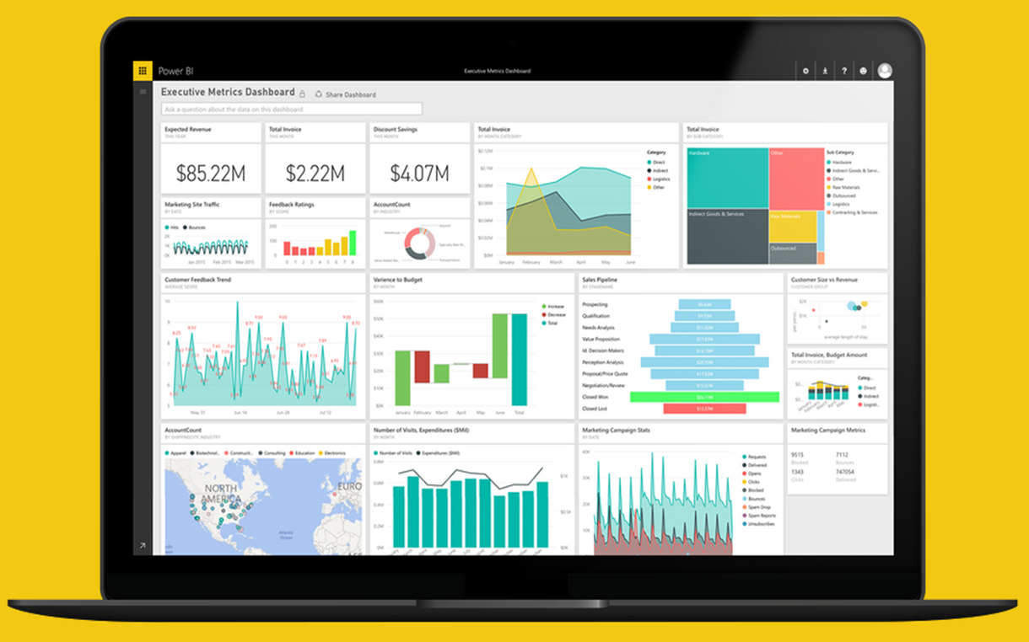
Project Professional Workshop Program
Module 5 – Fantastic Functions and Where to Find Them

Slide 5
COURSE OBJECTIVES
By the end of this course, you will be able to use DAX to create calculations in a Power BI Desktop data model. Specifically you will be able to:
Understand basic concepts of Data Modeling
Understand the consequences of data model design decisions
Understand concepts of calculated columns and measures
Gain familiarity with standard DAX patterns & CALCULATE
Understand evaluation contexts and their impact on calculations
Gain ability to parse data modeling formulas

Slide 6
Recap & DAX Concepts Module 4a

Slide 7
Module 4a - DAX Evaluation Contexts
Any DAX expression is evaluated inside a certain context
The context is the environment under which the formula is evaluated
“The surrounding area of the cell where DAX evaluated the formula”
2 Kinds
Row Context – the context that always contain a single row and DAX defines during the creation of the formula
Filter Context – based on the context defined by it’s current filters & environment
Notes:
Context
Oh boy…. This is the tough one
This does take some time to understand, but basically every DAX expression is evaluated inside a certain “environment”
This depends if it is a column or a measure, in a table or on it’s own
Row Context
More for Calculated Columns – iterates on every row of a table/column
Cannot look at other rows! Just the one it is on
Filter Context
Based on the current area or situation a expression is in
Can ignore row context, especially aggregations.
Not based on every row
For example, a measure of total sales when adding different columns and rows

Slide 8
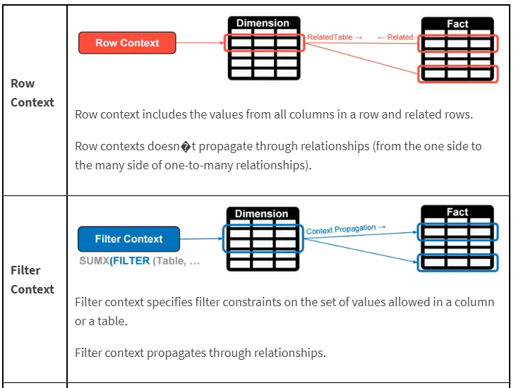
Module 4a – DAX Evaluation Contexts
Filter Context
Comes initially from the visual coordinates.
Can be modified by the functions like CALCULATE().
Follows the one to many relationships automatically.
Bidirectional filtering can be forced.
Row Context
Exists in calculated columns.
Exists in special DAX functions like SUMX and FILTER.
Does not follow relationship.
A row Context does not create a filter context.

Slide 9
DAX Function Types
Module 4a – DAX Evaluation Contexts
Scalar Functions
Table Functions
Scalar functions return a Single value as an output
Ex. SUM(Sale[Sales Amount])
Table functions return a Table as an output
Ex. ALL(GeographyDim)
There are other ways to classify functions – By kind of operation they perform etc.
Notes:
Scalar is a fancy word for using a single coordinate in the evaluation
What if you want bring in a Table or List of values and apply your calculation to them?

Slide 10
PATH to DAX Expertise
Module 4b – CALCULATE & Variables
Evaluation Contexts
CALCULATE
Calculated Columns and Measures
Notes:
Evaluation Context – Single biggest reason that people give up on DAX
Want to Simplify the Evaluation Context

Slide 11
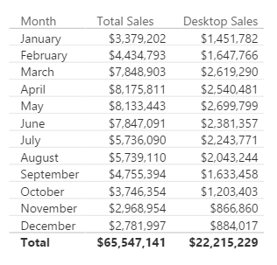
Here is how you do it with CALCULATE
Module 4b – CALCULATE & Variables
[Desktop Sales] = CALCULATE([Total Sales], CampaignDim[Device] = "Desktop")
Use CALCULATE function to create a Measure which filters down to Desktop Sales
Notes:
Note that even if you apply a “Device” Slicer to this page, the measure [Desktop Sales] will always show Desktop

Slide 12
Module 4b – CALCULATE & Variables
[Desktop Sales] = CALCULATE([Total Sales], CampaignDim[Device] = "Desktop")
[Tablet Sales] = CALCULATE([Total Sales], CampaignDim[Device] = “Tablet")
[Mobile Sales] = CALCULATE([Total Sales], CampaignDim[Device] = “Mobile")
Add Filter
Ignore Filter
Update Filter
Convert Row Context to Filter Context
Notes:
Demo: Table from “Calculate-Add” report
Note the effect that the Year Slicer has on the table (All items change)
When the Device Slicer is selected, only “Total Sales” changes.
Filter Context : Jan + 2015
Jan + 2015 + Desktop
Jan + 2015 + Tablet

Slide 13
Module 4b – CALCULATE & Variables
[Total Sales All Geo] = CALCULATE([Total Sales], ALL(GeographyDim))
[Total Sales All States] = CALCULATE([Total Sales], ALL(GeographyDim[State]))
[Total Sales All Selected States] = CALCULATE([Total Sales], ALLSELECTED(GeographyDim[State]))
Add Filter
Ignore Filter
Update Filter
Convert Row Context to Filter Context
Notes:
DEMO “Calculate- Ignore” Tab:
The table visualization, with each slide, expose the related column
Expose measure called [Total Sales All Geo] – Ignore filter on ANY column from the GeographyDim table, but allows filters from Year
Discuss that this measure can be used to calculate a % of Total measure
DEMO “Calculate- Ignore” Tab:
The table visualization, with each slide, expose the related column
Expose measure called [Total Sales All State] – Ignore filter on the STATE column from the GeographyDim table, but allows filters from Year
Slice on City (Aberdeen is good)
DEMO “Calculate- Ignore” Tab:
The table visualization, with each slide, expose the related column
Expose measure called [Total Sales All Selected State] – Ignore filter on the STATE column from the GeographyDim table, but allows filters from Year
Slice on City (Aberdeen is good), then select multiple State, see that the measure now only displays the total for selected states.

Slide 14
Module 4b – CALCULATE & Variables
[2014 Sales] = CALCULATE([Total Sales], DateDim[Year] = 2014)
Add Filter
Ignore Filter
Update Filter
Convert Row Context to Filter Context
Notes:
DEMO “Calculate- Update” Tab:
The measure called [2014 Sales] – Ignores filter on the Year Slicer.
This is different than just using FILTER because Calcuate updates the filter context, FILTER creates a filter Context

Slide 15
Module 05: Fantastic Functions & Where to Find Them

Slide 16
Module 05 – Popular DAX Expressions
Fantastic Functions and Where to Find them
Over 200+ DAX functions, with 10 Categories
New ones added monthly

Slide 17
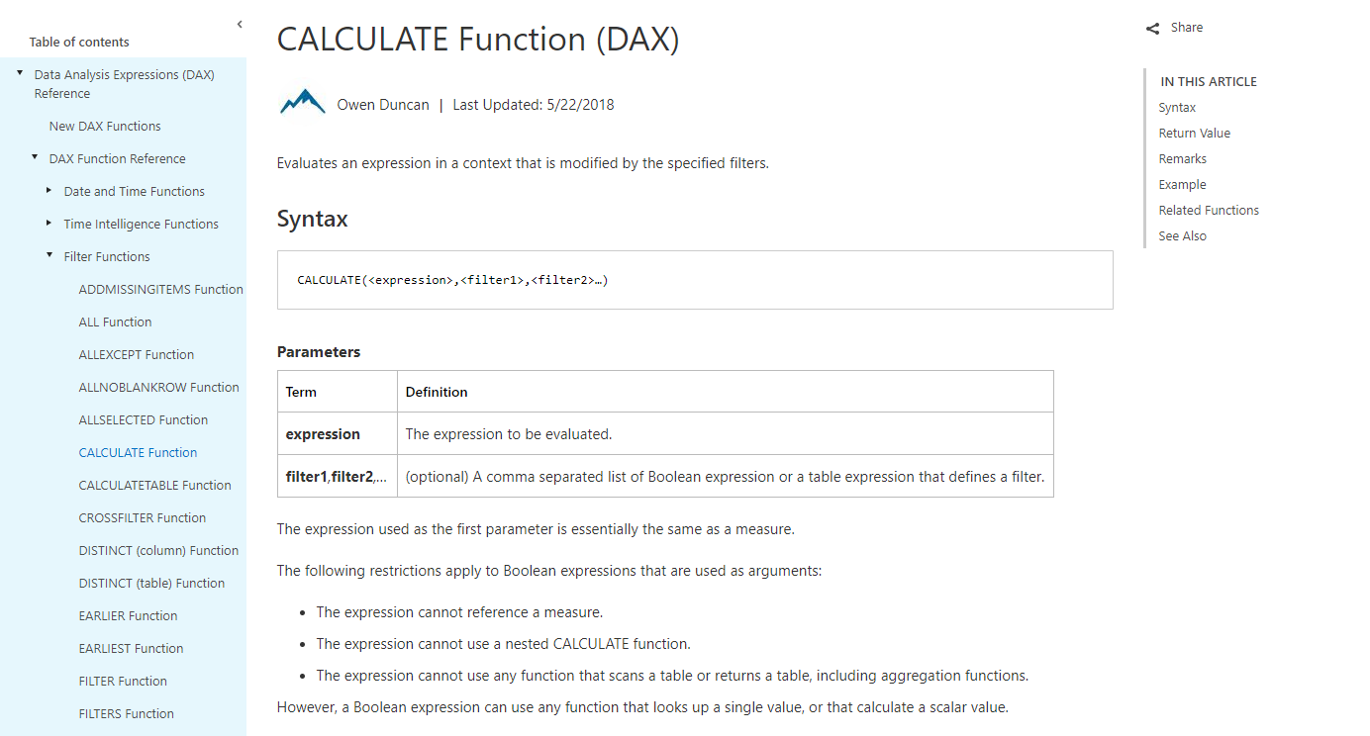

Slide 18
Module 05 – Popular DAX Expressions
MSDN gives every function:
Description
Syntax & Parameters for function
Return Value
Example
Remarks & Related

Slide 19
Module 05 – Popular DAX Expressions
DAX Function Main Categories
Date and Time Functions
Time Intelligence Functions
Filter Functions
Information Functions
Logical Functions
Math & Trig Functions
Statistical Functions
Text Functions

Slide 20
Module 05a: The Basics DAX

Slide 21
Module 05a – The Basics
Why you need to Know the Basics
These create your foundational measures
Build off the Basics
More reliable, formatting options
Begin to learn how DAX works
Notes:
The Basic functions can only be known as the “Commons”, or the base functions. These are the ones that do your simple calculations, like SUM or AVERAGE or DIVIDE.
You use these in the more complex functions, and this greatly helps with not redoing the same logic in more complex formulas.
Also ensures reliable data from the start.

Slide 22
Module 05a – The Basics
Every DAX Function has required “ingredients” (Parameters)
Parameters can be an expression, table, column, value, etc.
Important to understand parameters per function
They also all have a specified Return Value
Can be an expression, scalar value, or even a table
Notes:
So let’s start with what make ups a DAX function.
Think of DAX functions like a Recipe. Every DAX recipe has required instructions & ingredients. These ingredients are known as parameters.
The parameters, like ingredients, need certain types of input to work correctly. You would never look at a cake recipe and subsite salt for sugar!
Parameters thus can make up a variety of inputs. Some functions need a table expression, a scalar expression, or a true /false.
Also, like a Cake, once you put the parameters in, every dax function (even ones that are nested) return a certain value.
Parameter Names
Paramter Description
expression Any DAX expression that returns a single scalar value, where the expression is to be evaluated multiple times (for each row/context).
value Any DAX expression that returns a single scalar value where the expression is to be evaluated exactly once before all other operations.
table Any DAX expression that returns a table of data.
tableName The name of an existing table using standard DAX syntax. It cannot be an expression.
columnName The name of an existing column using standard DAX syntax, usually fully qualified. It cannot be an expression.
name A string constant that will be used to provide the name of a new object.
order An enumeration used to determine the sort order.
ties An enumeration used to determine the handling of tie values.
type An enumeration used to determine the data type for PathItem and PathItemReverse.

Slide 23
Module 05a – The Basics
Examples
SUM
Syntax – SUM ( <column> )
Parameters – column, contains the numbers to sum
Return Value – a decimal number
IF
Syntax – IF ( <logical_test> , <value_if_true> , <value_if_false> )
Parameters –
Logical test – any value or expression that is TRUE or FALSE
If true – the value that is return if the test is TRUE
If false – the value that is returned if the test is FALSE
Return Value – any type of value that can be return by an expression
Notes:
Lets take a look at 2 examples. Basic ones from Excel but we see the ingredients are different form Excel.
For SUM, you can see that all it needs a Column. That’s it. But nothing more or less. It returns the total of that column. This is part why you do not reference single cells, and you do not use SUM in a column. Only a Measure.
SUM always takes a column, that’s it. Returns all numbers contained in the Column
IF works based on a row by row basis. Same as Excel, but the value if true for that row.

Slide 24
Module 05a – The Basics
DAX Functions are not all equal.
Some DAX functions are meant solely to be an expression, value, or filter for another Function.
Thus, all DAX Functions are not meant to be used alone.
Nested Functions, or Companion Functions
Notes:
This brings up the important aspect that DAX functions are not all alike. They do not all return or have the same indented purposes.
If a function needs a table expression, you cannot use SUM for example. You need a function that returns a table. Even if it is virtual.
These base functions are used usually alone, but complex functions are not.
Examples of a companion function is DatesYtD, or simply just “filtering” a table

Slide 25
Module 05a – The Basics
Nested Functions Examples
CALCULATE
Syntax – CALCULATE ( <expression> , <filter1> , <filter2>)
Parameters
Expression – what you are evaluating (SUM)
Filter1, filter2… - a list of Boolean expression or a table expression that makes a filter
Return Value – the value that is the result of the expression
CALCULATE ( SUM ( Table[Column] ) , Table[Column] = “Yes” )
CALCULATE ( [Measure] , DATESYTD ( Table[DateColumn] ) )
Notes:
Let’s take a look at a more complex Function that used other functions (nested). CALCULATE is our best example.
CALCULATE needs an expression, pretty much what we want the output to be. What are you aggregating or trying to get?
Then, it needs a list (at least one) of true / false or table expressions that are a filter. These are usually some type of functions or yes or no values.
Finally, it returns the result of the expression using the filters you provided.
Take a look at the first example. The expression is the SUM of a column, and then we are saying that a certain table and the column must be “Yes” for each row. Thus, the filter we are using is a table filter.
The next example is using a Measure already created (base function) as the expression, and then we are using the DATESYTD, which always return an unique table with one column for dates up to the current date. So the Measure is going to be evaluated in the context of that DatesYTD and any filter context in our visuals, or come from the outside.
Examples of a companion function is DatesYtD, or simply just “filtering” a table

Slide 26
Module 05a – The Basics
The Commons - Measures
SUM
DIVIDE
COUNTROWS
DISTINCTCOUNT
MAX
AVERAGE
The Commons - Columns
IF
RELATED
LOOKUPVALUE
ISBLANK
Notes:
So lets take a look at our common functions. We have them broken out based on for Measures (to aggregate) and by Columns (row by row).

Slide 27
Module 05a – The Basics – Commons Measures
SUM
Adds the numbers of a Column together
DIVIDE
Division and returns alternate result if by 0
COUNTROWS
Counts the number of Rows in a table
DISTINCTCOUNT
Counts the number of distinct values in a column
MAX
Returns MAX value from a Column

Slide 28
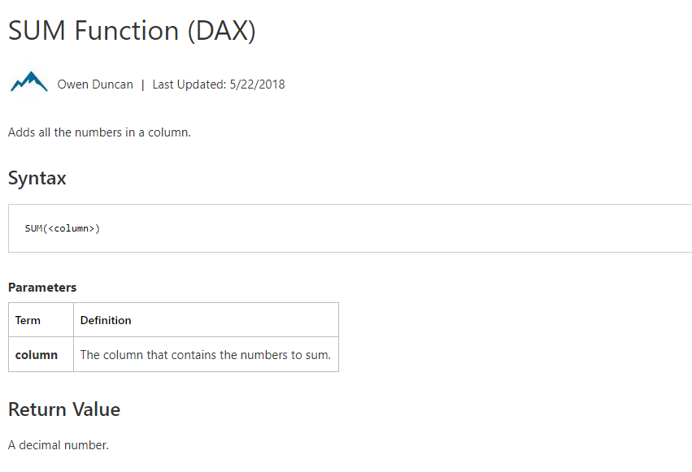
Module 05a – The Basics – Commons Measures
Notes:
You basic SUM. It does everyone you expect it too.

Slide 29
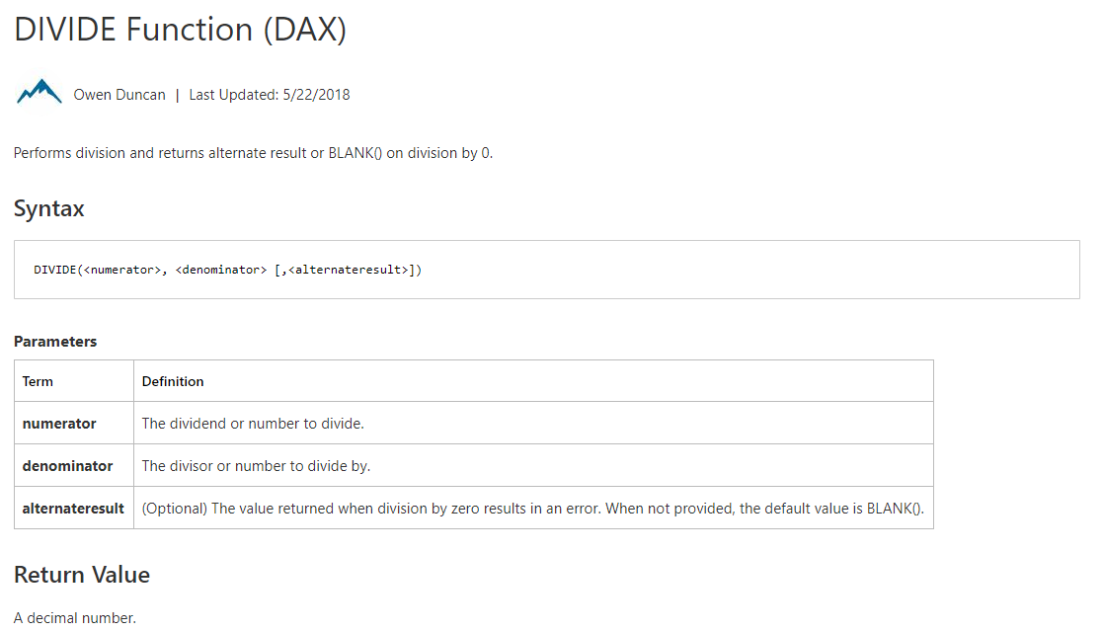
Module 05a – The Basics – Commons Measures
Notes:
Divide.

Slide 30
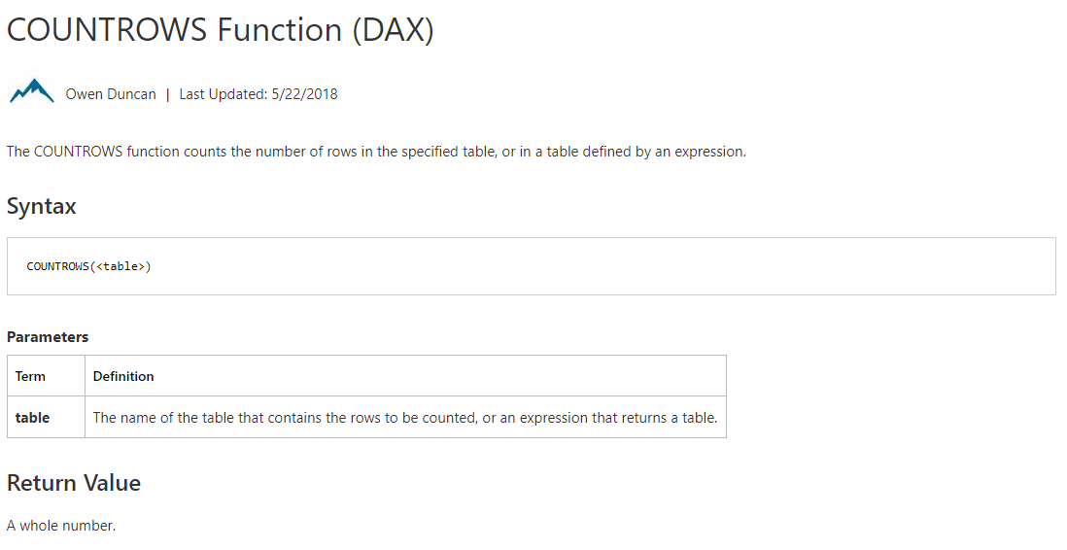
Module 05a – The Basics – Commons Measures

Slide 31
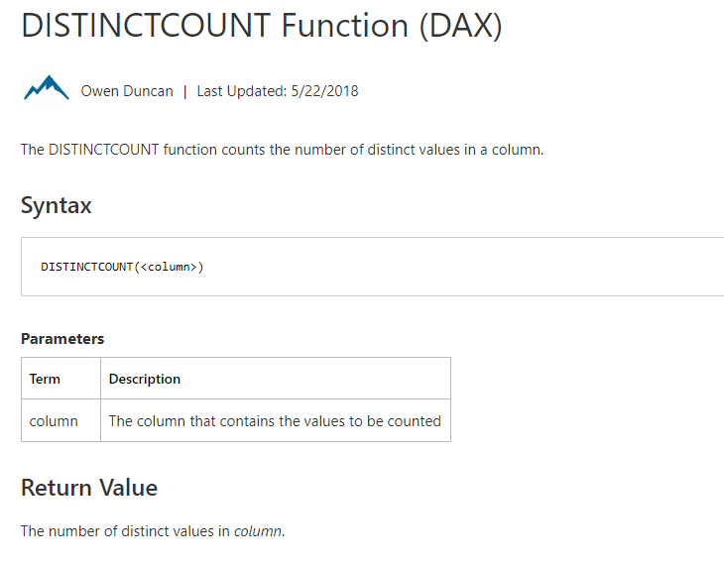
Module 05a – The Basics – Commons Measures

Slide 32
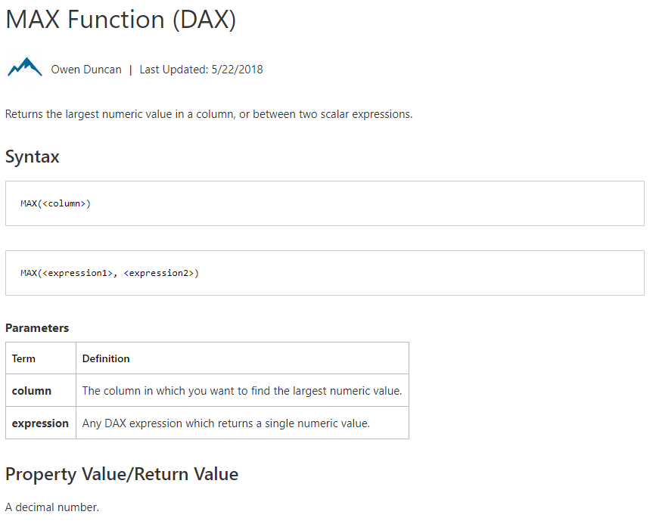
Module 05a – The Basics – Commons Measures

Slide 33
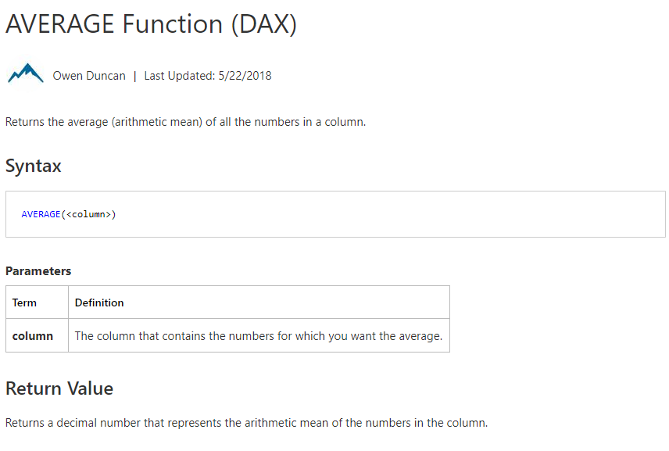
Module 05a – The Basics – Commons Measures

Slide 34
Module 05a – The Basics – Commons Columns
IF
Checks if a condition is met (just like Excel)
RELATED
Returns a related value from another table
LOOKUPVALUE
Retrieves a value from a table (not related)
Like VLOOKUP or INDEX MATCH
ISBLANK
Checks if a value is blank (TRUE or FALSE)

Slide 35
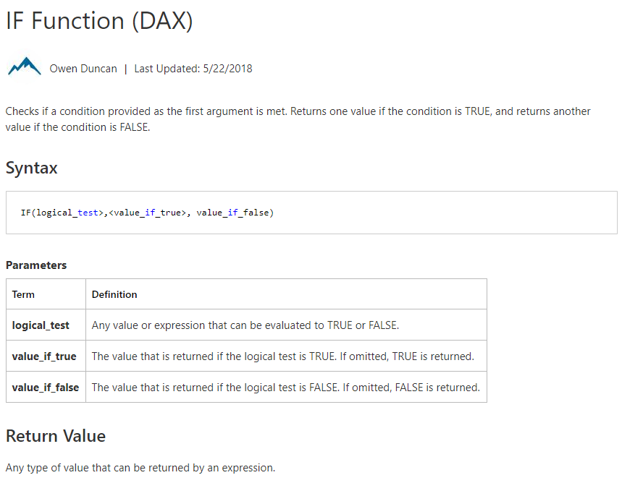
Module 05a – The Basics – Commons Columns

Slide 36
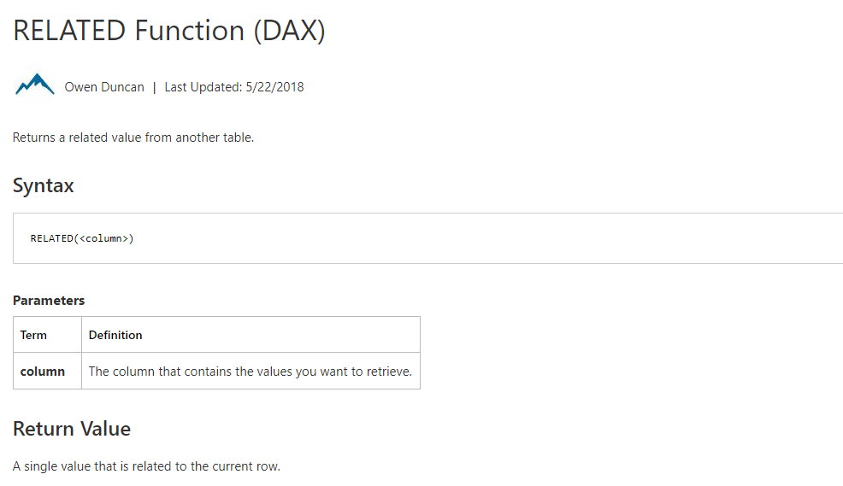
Module 05a – The Basics – Commons Columns

Slide 37
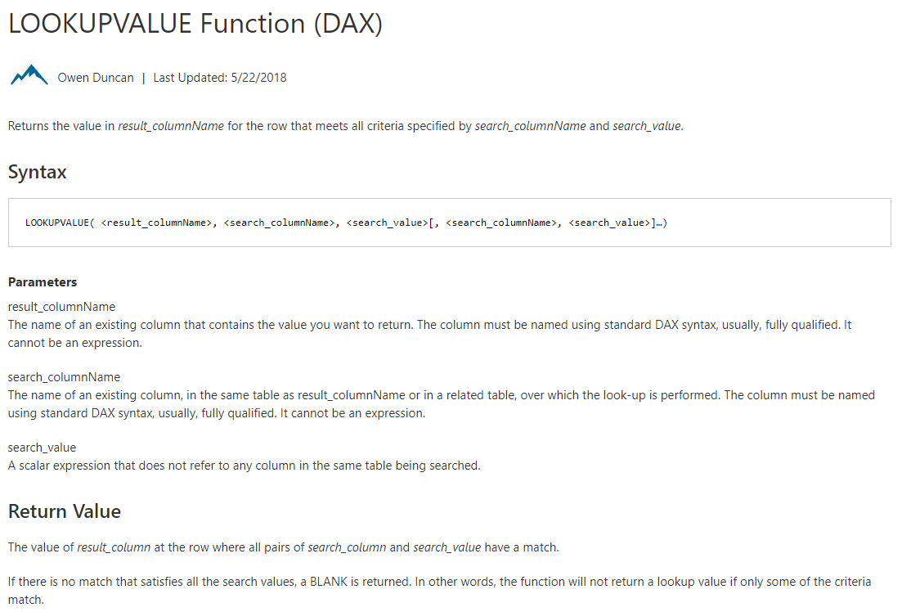
Module 05a – The Basics – Commons Columns

Slide 38
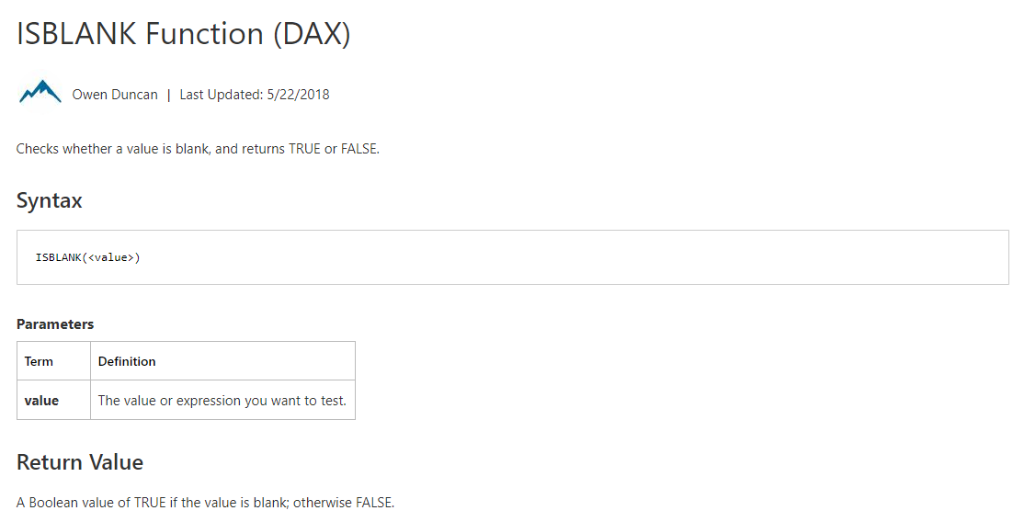
Module 05a – The Basics – Commons Columns

Slide 39
Module 05a: Demo

Slide 40
Module 05b: Commons Super Stars

Slide 41
Module 05b – The Super Stars
Once you have your “Commons” down, now you can build off of them with Filter / Info functions
Ability to manipulate context to create dynamic calculations
Time Intelligence using time periods to compare
Also known as the SUPER STARS
Notes:
Ok great, Commons are down. Now we can build off to create SUPER STARS.
These really give you the full power of DAX and in your reporting.

Slide 42
Module 05b – The Super Stars
Super Star Functions are usually nested or combined with other Functions
Cannot just use single function alone in a formula
Requires a common or basic function to support it
These transform or modify the context or expression of a common evaluation
Notes:
As we said, Super Star functions are usually combined with other functions.

Slide 43
Module 05b – The Super Stars
Super Star Functions – Measures
CALCULATE
FILTER
USERELATIONSHIP
ALL FUNCTIONS
IN
Super Star Functions – Tabular
DISTINCT
VALUES
UNION
SUMMARIZE
SWITCH

Slide 44
Module 05b – The Super Stars Measures
CALCULATE
Evaluates an expression modified by specific filters (Updates, Adds, etc.)
Use expressions that define a filter
FILTER
Returns a table that represents a subset of another table or expression
Commonly use the FILTER argument inside CACULATE
USERELATIONSHIP
Makes an inactive relationship active in the specific calculation
Used for tables with multiple date periods (Order Date, Shipped Date)
ALL FUNCTIONS
ALL, ALLEXCEPT, ALLSELECTED
Ignores any filters that have been applied
IN
Mirror of the SQL “IN"

Slide 45
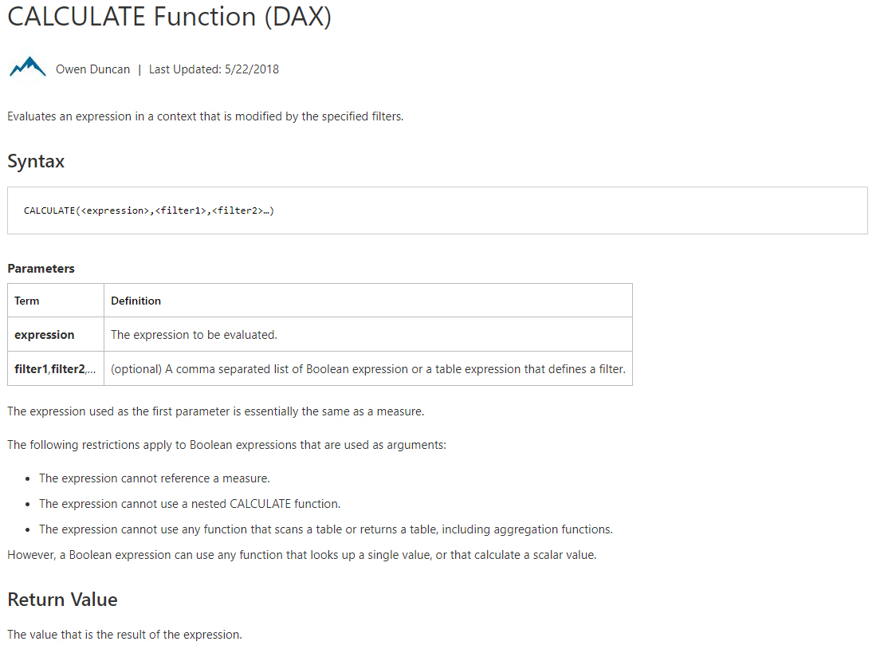
Module 05b – The Super Stars Measures

Slide 46
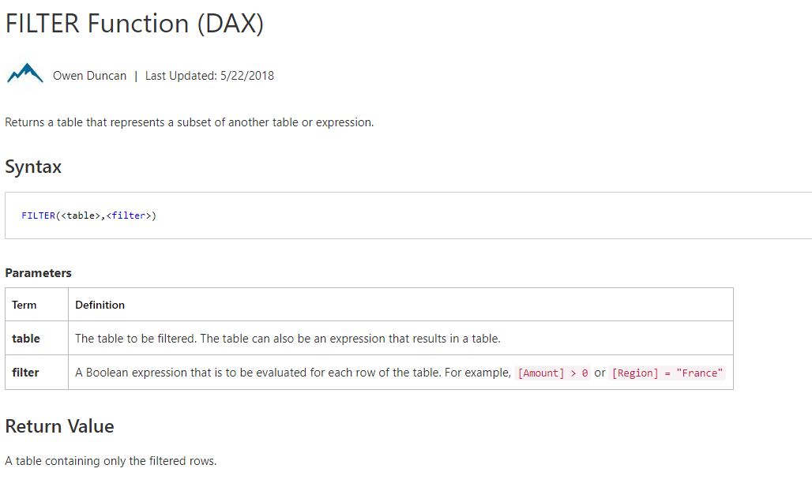
Module 05b – The Super Stars Measures

Slide 47
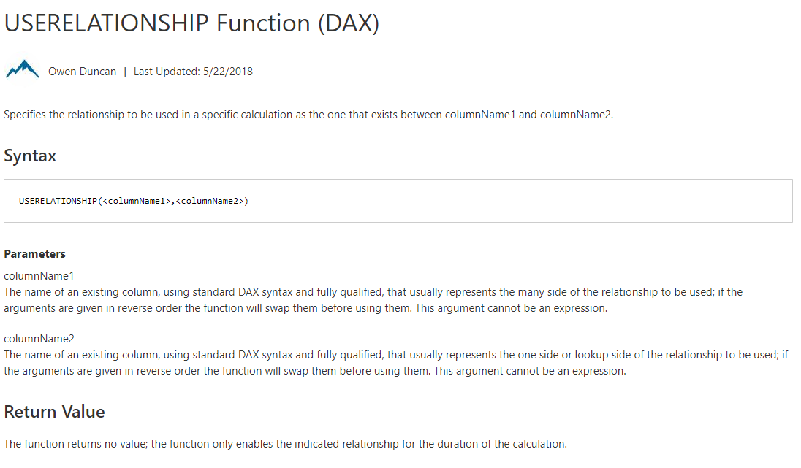
Module 05b – The Super Stars Measures

Slide 48
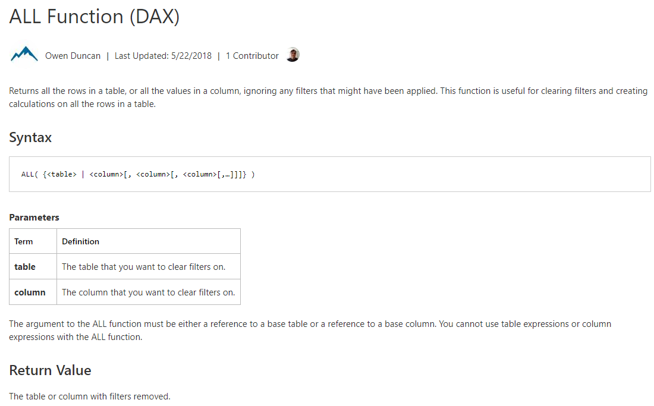
Module 05b – The Super Stars Measures

Slide 49
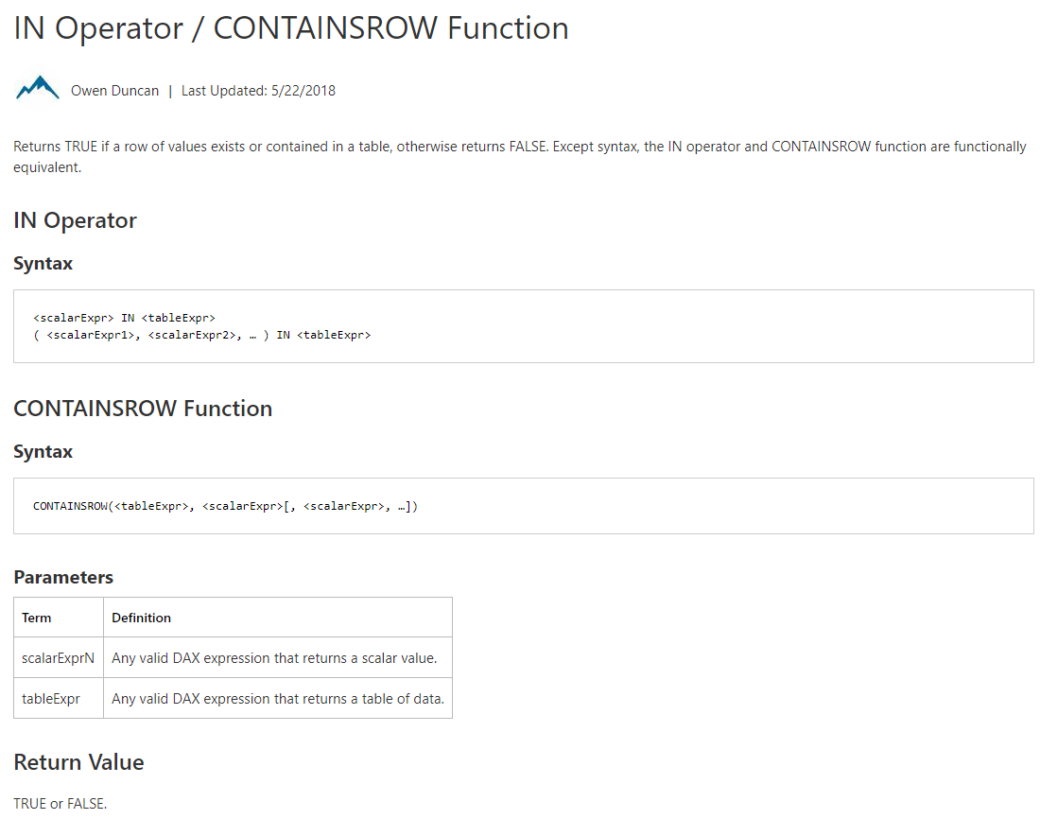
Module 05b – The Super Stars Measures

Slide 50
Module 05b – The Super Stars Tabular
DISTINCT & VALUES
Both return a column of unique values (one column returned)
Similar for each, but VALUES will return blank values as well
UNION
Creates a unique joined table from a pair of tables
Uses – to create a bridge to relate tables together
SUMMARIZE
Returns a table that is grouped by columns
Can create columns based on Groups
SWITCH
Evaluates expression against of values and returns result if true
Like nested IF statements

Slide 51
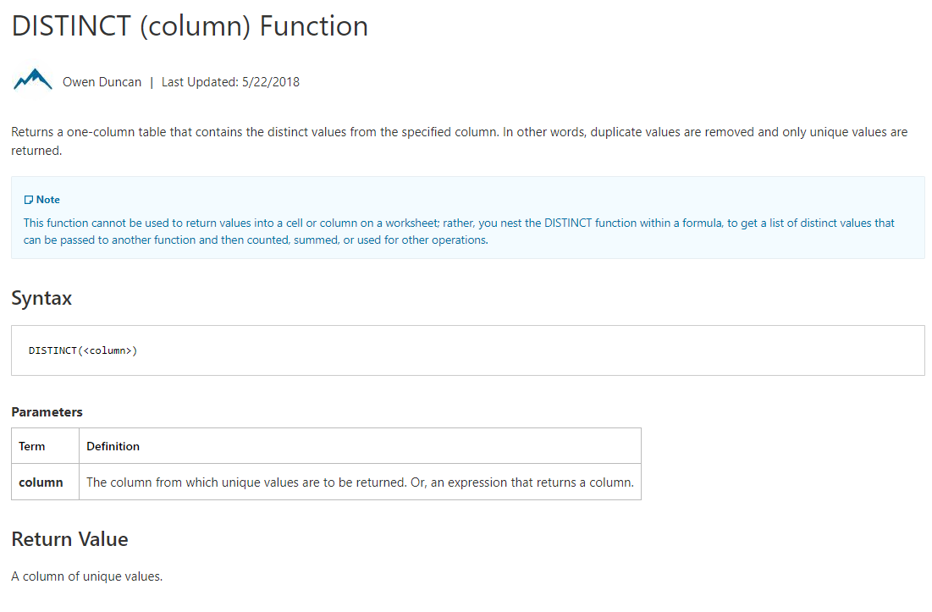
Module 05b – The Super Stars Tabular

Slide 52
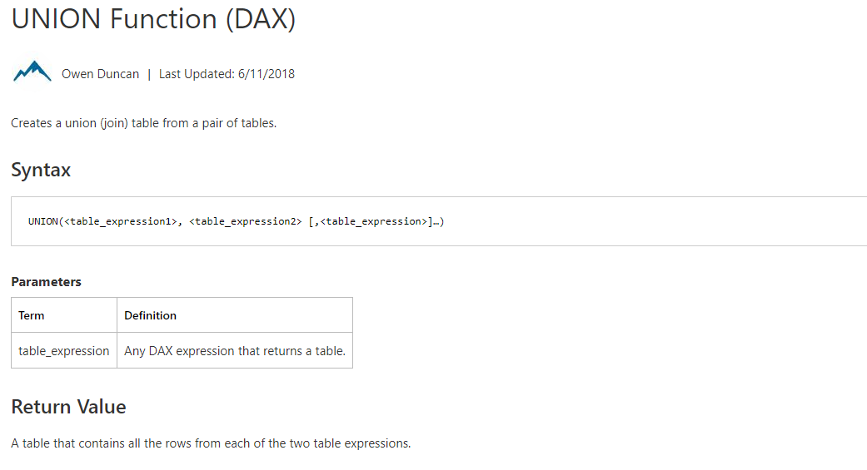
Module 05b – The Super Stars Tabular

Slide 53
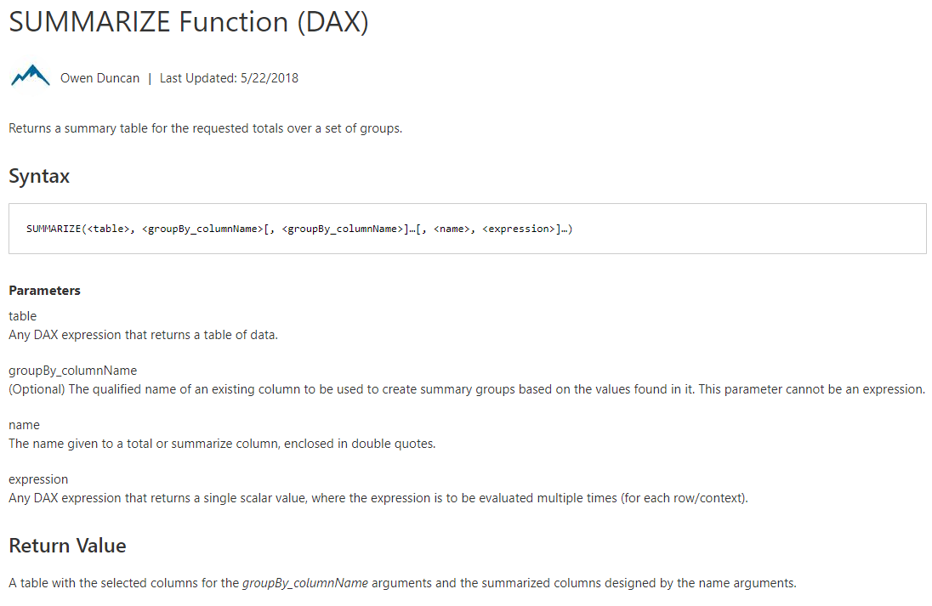
Module 05b – The Super Stars Tabular

Slide 54
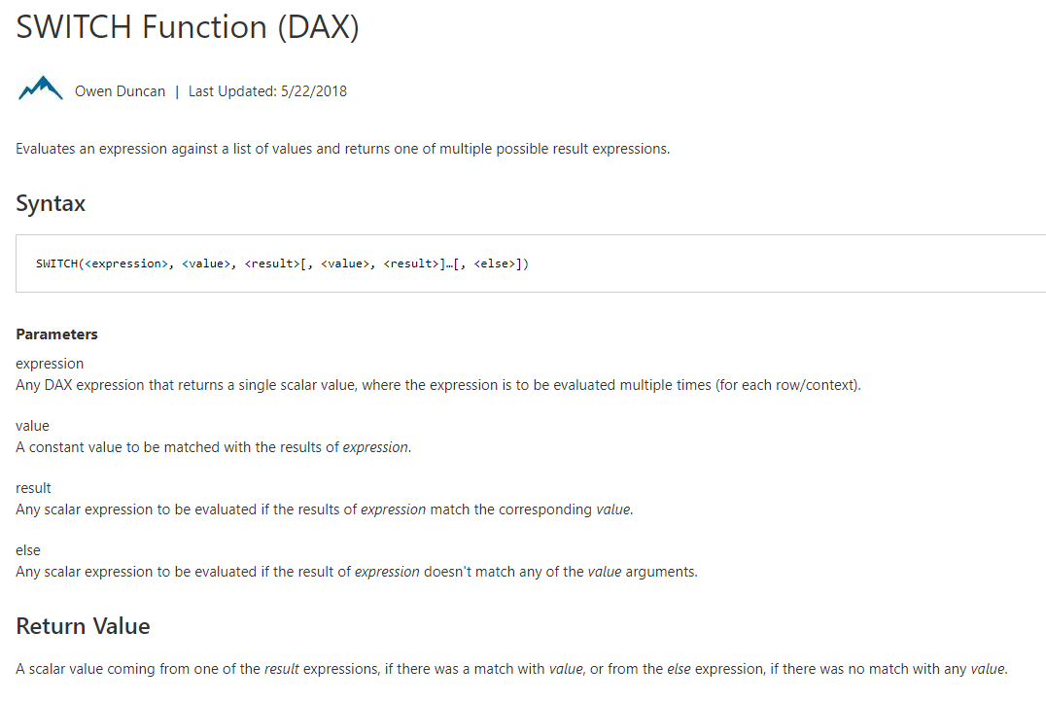
Module 05b – The Super Stars Tabular

Slide 55
Module 05b: Demo

Slide 56
Module 05c: Date & Time Intelligence

Slide 57
Module 05c – Date & Time Intelligence
One of the most powerful features of DAX
Modify time periods, compare previous or parallel time frames
Useful and built-in Intelligence for Month, Quarter, Years

Slide 58
Module 05c – Date & Time Intelligence
Time Intelligence – Measures
DATES (MTD, QTD, YTD)
LASTNONBLANK | FIRSTNONBLANK
DATESBETWEEN | DATESINPERRIOD
DATEADD
SAMEPERIODLASTYEAR
ENDOF (MONTH | QUARTER | YEAR)
PARALLELPERIOD
STARTOF (MONTH | QUARTER | YEAR)
Date and Time – Measures
TODAY
DATE
CALENDAR
DATEDIFF
YEAR
WEEKDAY

Slide 59
Module 05c – Date and Time Measures
TODAY
Returns the current date
DATE
Returns the specified date
CALENDAR
Returns a table with one column of dates between specific dates
DATEDIFF
Returns the number of units between two input dates
DAY | MONTH | YEAR
Returns a number representing the particular value

Slide 60
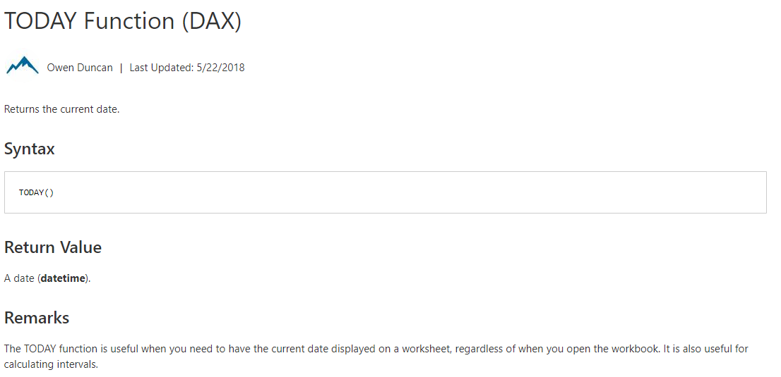
Module 05c – Date and Time Measures

Slide 61
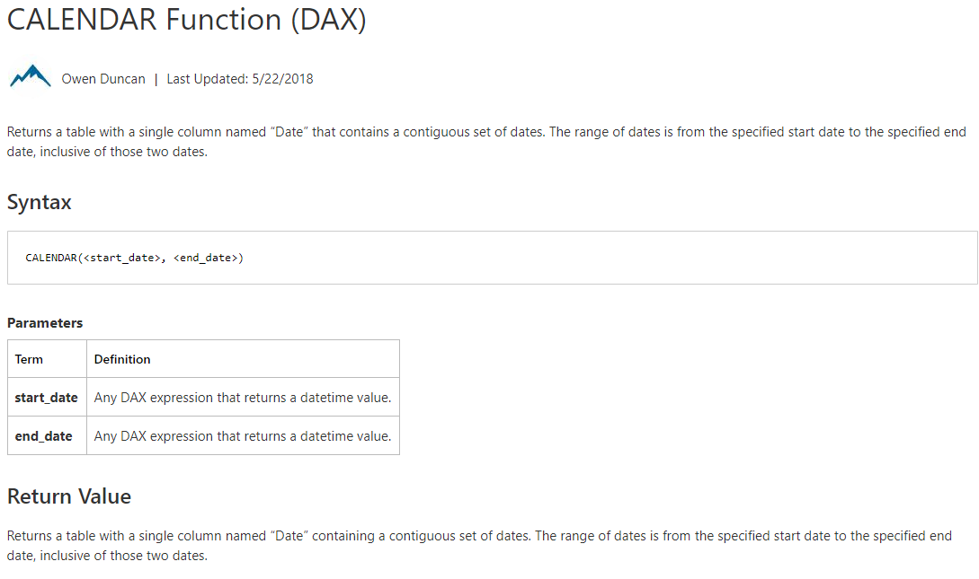
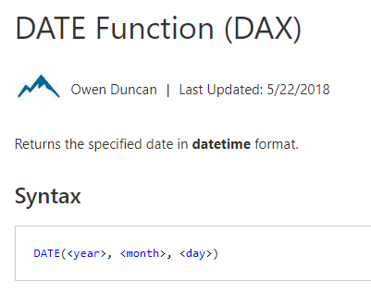
Module 05c – Date and Time Measures

Slide 62
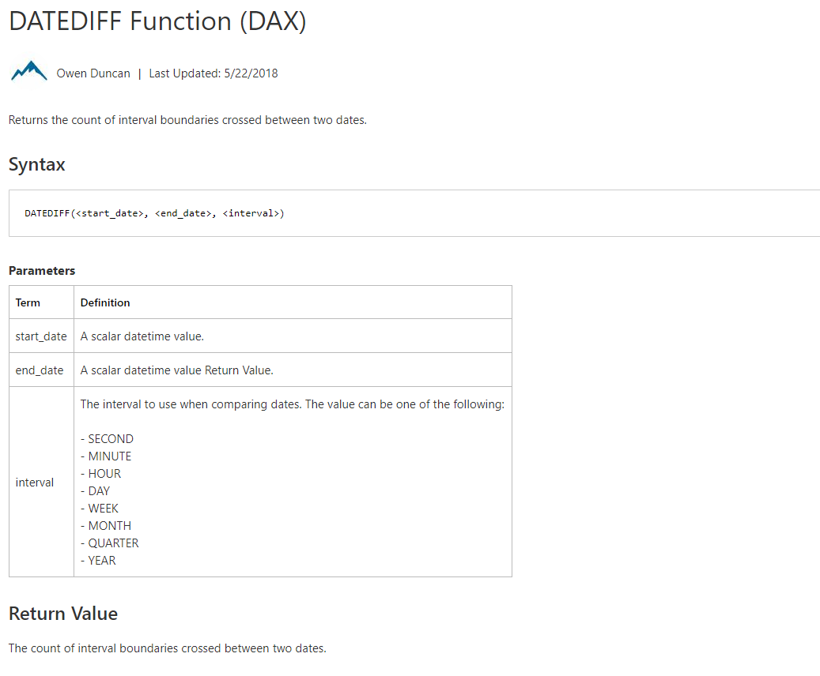
Module 05c – Date and Time Measures

Slide 63
Module 05c – Time Intelligence Measures
DATESMTD | DATESQTD | DATESYTD
Returns a set of dates in the period up to the current date
LASTNONBLANK | FIRSTNONBLANK
Returns first | last value in a column
DATESBETWEEN | DATESINPERIOD
Returns the dates between two given dates or in a given period
DATEADD
Moves the given set of dates by a specified interval
SAMEPERIODLASTYEAR | PARALLELPERIOD
Returns a set of dates from the previous year or parallel period
STARTOF | ENDOF (MONTH | QUARTER | YEAR)
Returns either the start of end of the specified period as date

Slide 64
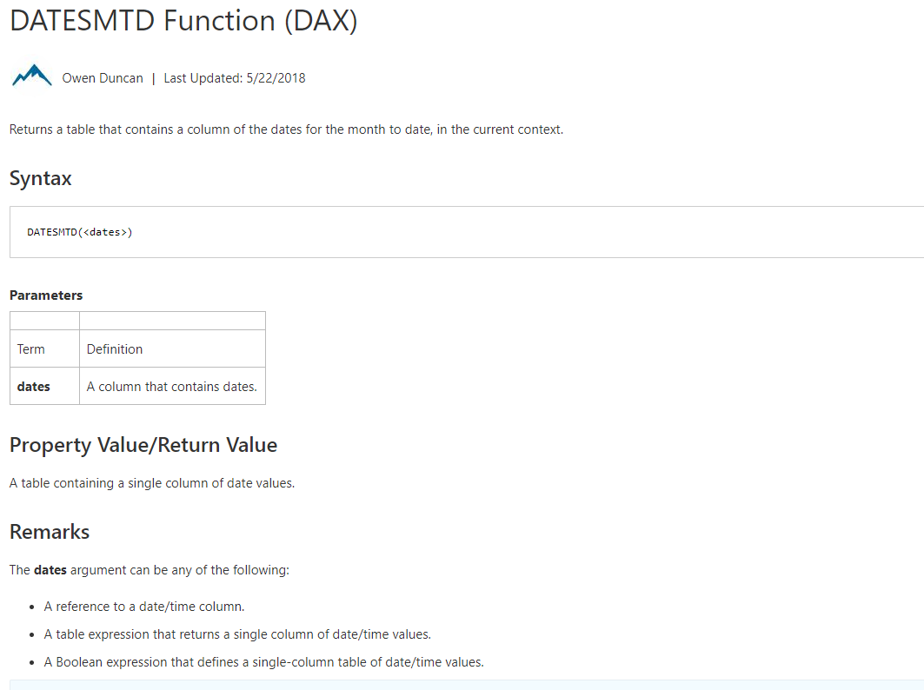
Module 05c – Time Intelligence Measures
Notes:
Same for QtD, YtD

Slide 65
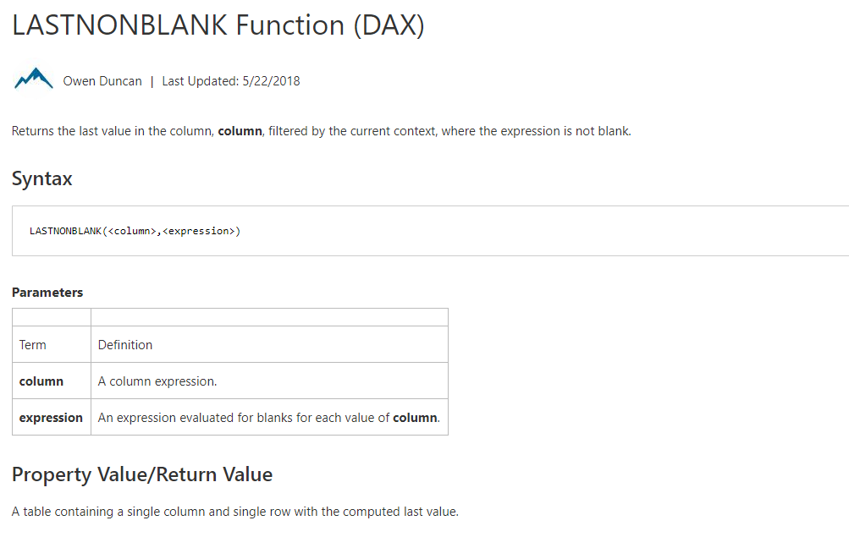
Module 05c – Time Intelligence Measures

Slide 66
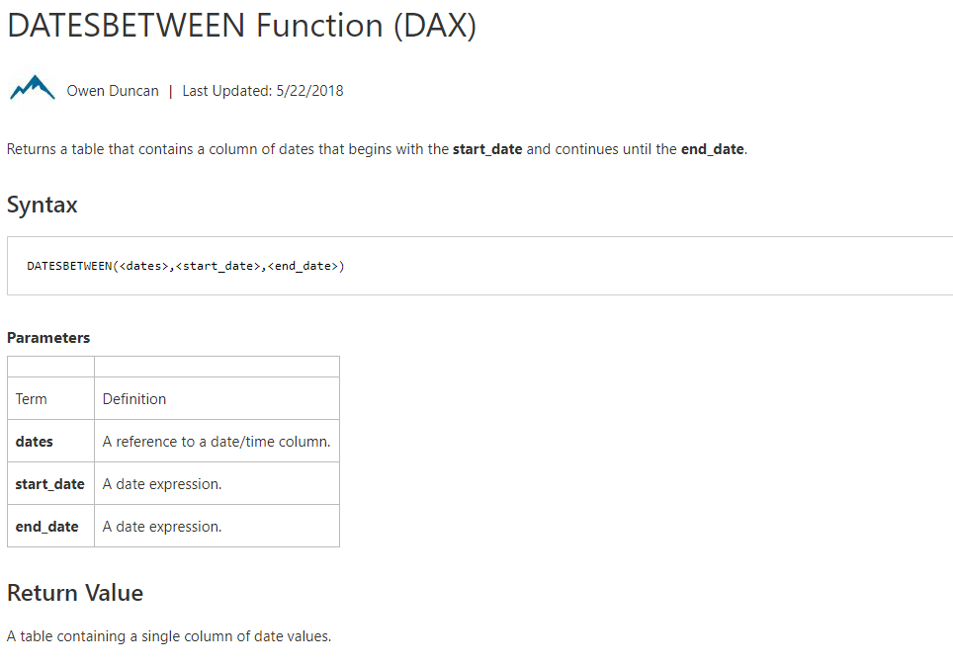
Module 05c – Time Intelligence Measures

Slide 67
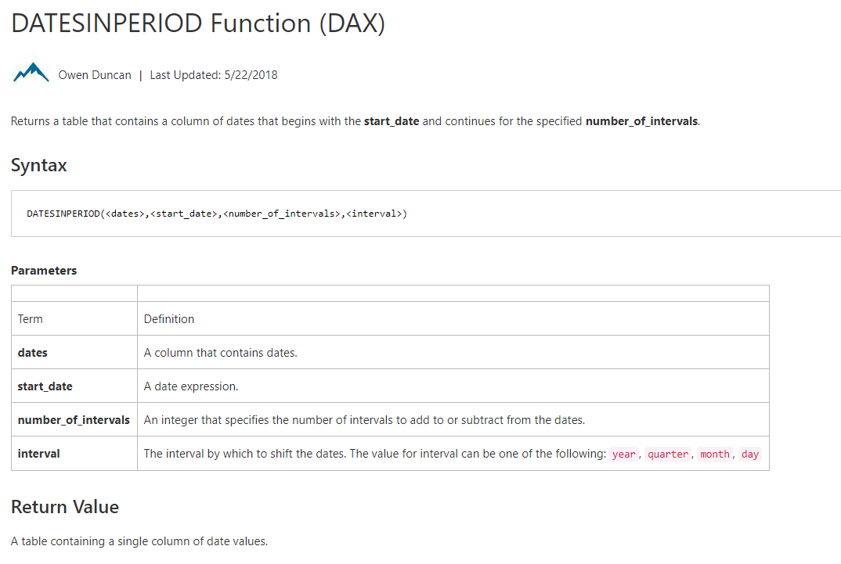
Module 05c – Time Intelligence Measures

Slide 68
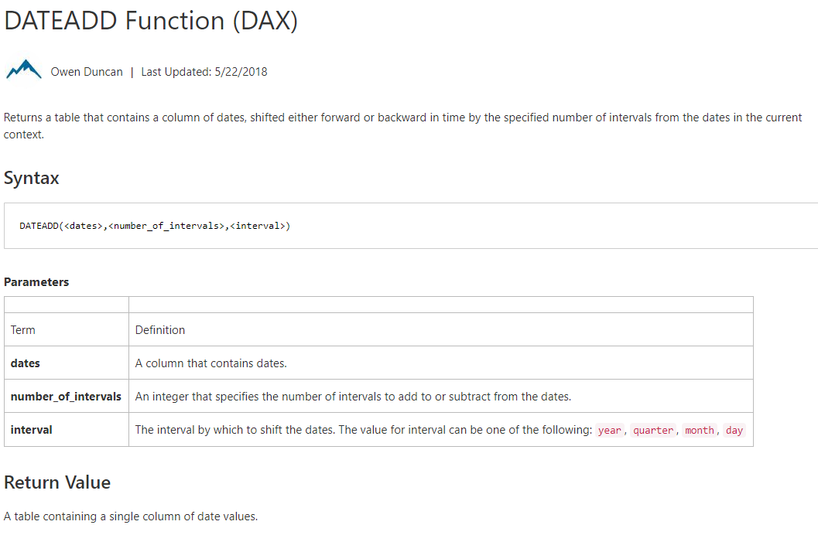
Module 05c – Time Intelligence Measures

Slide 69
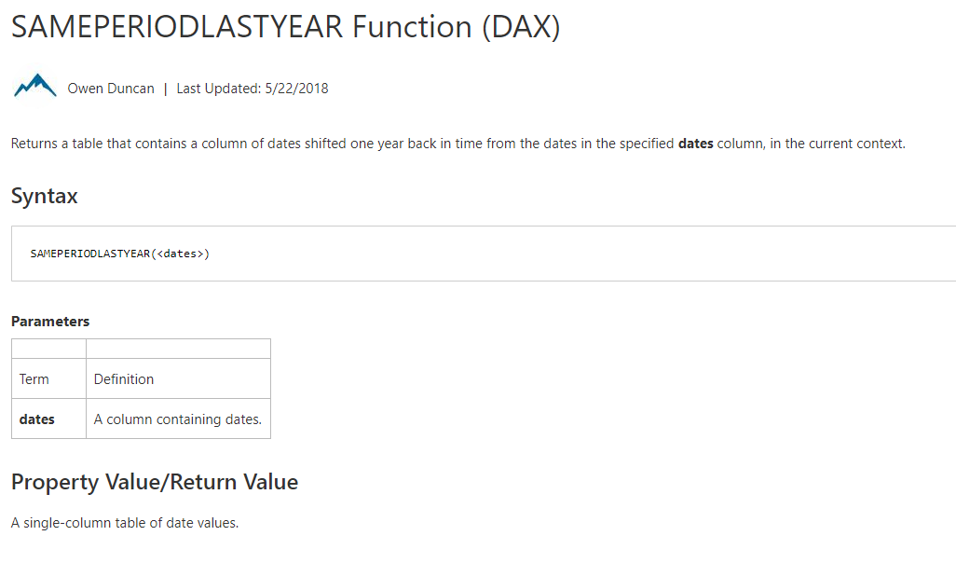
Module 05c – Time Intelligence Measures

Slide 70
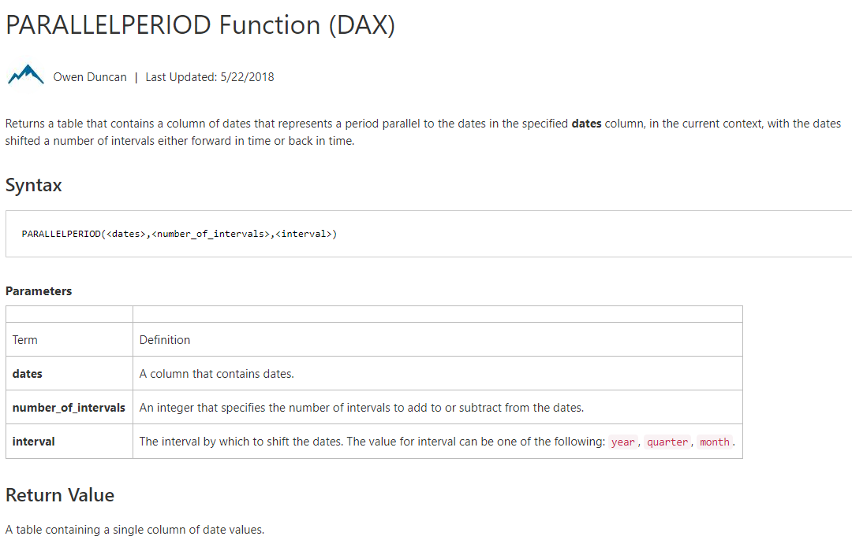
Module 05c – Time Intelligence Measures

Slide 71
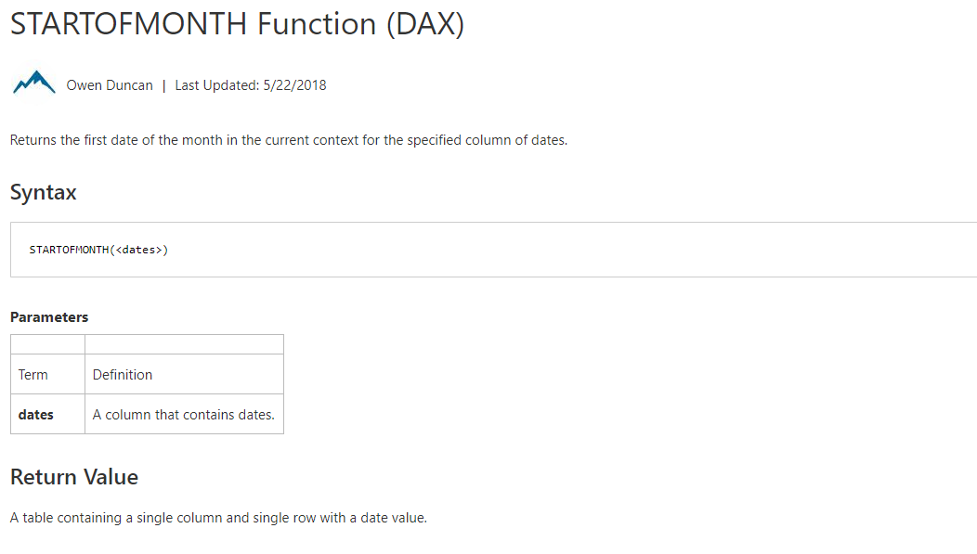
Module 05c – Time Intelligence Measures

Slide 72
Module 05c – Examples
Year to Date
Period over Period (Total)
Period over Period (by current time frame)
Notes:
Total Sales Last Month =
CALCULATE([Total Sales],
PREVIOUSMONTH(DateDim[Date]))
MoM =
DIVIDE([Total Sales] - [Total Sales Last Month],
[Total Sales Last Month])

Slide 73
Module 05c: Demo
Notes:
Year to Date
Period over Period (Total)
Period over Period (by current time frame)
Rolling Time frame

Slide 74
Module 05d: Variables

Slide 75
MODULE OBJECTIVES
Be able to parse advanced DAX formulas (e.g., cumulative functions)
Gain familiarity with standard DAX patterns
Introduction to resources for further learning

Slide 76
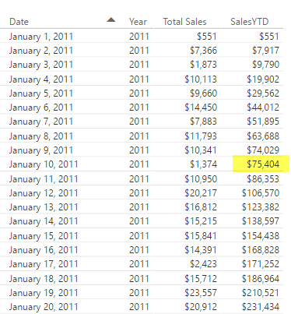
Before we get to Time Intelligence - Let us apply all of the DAX techniques
Advanced DAX
[SalesYTD] =
CALCULATE (
[Total Sales],
FILTER (
ALL ( DateDim),
DateDim[Year] = MAX ( DateDim[Year] )
&& DateDim[Date] <= MAX(DateDim[Date])
)
)
Let us take a super complicated DAX statement and break it down and understand what it means
Notes:
Tab: Time Intelligence-YTD
Slides walk thru the logic – Follow the narrative of the next 5 slides

Slide 77
Before we get to Time Intelligence - Let us apply all of the DAX techniques
Advanced DAX
[SalesYTD] =
CALCULATE (
[Total Sales],
FILTER (
ALL ( DateDim),
DateDim[Year] = MAX ( DateDim[Year] )
&& DateDim[Date] <= MAX( DateDim[Date] )
)
)
In a CALCULATE statement Filter arguments are evaluated first
The Filter in this case comes from a FILTER function
FILTER function is an iterator

Slide 78
Let us apply all of the data modeling techniques
Advanced DAX
[SalesYTD] =
CALCULATE (
[Total Sales],
FILTER (
ALL ( DateDim),
DateDim[Year] = MAX ( DateDim[Year] )
&& DateDim[Date] <= MAX( DateDim[Date] )
)
)
In a FILTER statement the input Table is evaluated first
ALL statement means take all DateDim

Slide 79
Let us apply all of the data modeling techniques
Advanced DAX
[SalesYTD] =
CALCULATE (
[Total Sales],
FILTER (
ALL ( DateDim),
DateDim[Year] = MAX ( DateDim[Year] )
&& DateDim[Date] <= MAX(DateDim[Date] )
)
)
Iterate through each row in DateDim
Check for condition based on row context and filter context
Pro Tip: if you need to concatenate two conditions with an AND use && for and OR use ||

Slide 80
Let us apply all of data modeling techniques
Advanced DAX
[SalesYTD] =
CALCULATE (
[Total Sales],
FILTER (
ALL ( DateDim),
DateDim[Year] = MAX ( DateDim[Year] )
&& DateDim[Date] <= MAX(DateDim[Date] )
)
)
Now you have a FILTERED list of dates
Use this to update the filter context (since it is in a CALCULATE statement)

Slide 81
Let us apply all of the data modeling techniques
Advanced DAX
[SalesYTD] =
CALCULATE (
[Total Sales],
FILTER (
ALL ( DateDim),
DateDim[Year] = MAX ( DateDim[Year] )
&& DateDim[Date] <= MAX(DateDim[Date] )
)
)
Use updated FILTER context to evaluate ‘Total Sales’

Slide 82
Introducing Time Intelligence – There is an App for that!!
Advanced DAX – Time Intelligence
[SalesYTD Easier] =
CALCULATE (
[Total Sales],
DATESYTD(DateDim[Date])
)
This allows you to write the formula without being a DAX guru!
Microsoft is continuously improving Time Intelligence functions to make it simple to use
Time Intelligence functions are your friends – They will save you time!

Slide 83
Month Over Month
Advanced DAX – Time Intelligence
Total Sales Last Month =
CALCULATE([Total Sales],
PREVIOUSMONTH(DateDim[Date]))
MoM =
DIVIDE([Total Sales] - [Total Sales Last Month],
[Total Sales Last Month])
DAX has several shortcut Time Intelligence functions
Notes:
Additional calculations to discuss commonly used scenarios
Calculates based on same day in prior month
MoM – Month over Month

Slide 84
Monthly Active Users
Advanced DAX – Time Intelligence
[Monthly Active Users] =
CALCULATE(
SUMX(VALUES(Sales [CustomerId]),1),
ALL('DateDim'),
DATESINPERIOD('DateDim'[Date],
LASTDATE('DateDim'[Date]), -1, MONTH)
)
Sumx vs DistinctCount of CustomerID
SUMX can be more performant
Notes:
Another commonly used scenario
Calculates based on same day in prior month – Discuss usage of DATESINPERIOD and LASTDATE

Slide 85
Other Time Intelligence Functions
Advanced DAX – Time Intelligence
DATESINPERIOD
DATESYTD
DATESQTD
NEXTMONTH NEXTYEAR
PREVIOUSYEAR PREVIOUSMONTH SAMEPERIODLASTYEAR
PARALLELPERIOD
Pro Tip: Learn about Time Intelligence functions - https://msdn.microsoft.com/en-us/library/ee634763.aspx

Slide 86
KNOWLEDGE CHECK Module 5
Can I parse advanced DAX formulas?
What are some standard DAX patterns?
Which time intelligence functions are built-in to DAX?

Slide 87
Power BI Support Resources
Contact Support
Report Errors, Issues – Support.PowerBI.com
Resources use presentation mode to click the hyperlinks
Community.PowerBI.com – Community Forum
Data Stories Gallery – Get inspired with Data Stories by other Power BI users
R-Visuals Gallery – Get inspired by others use of R for analyzing their data
Visuals.PowerBI.com – Custom PBI visuals and R visuals you can download and use in your story
Power BI Blog - weekly updates
User Voice for Power BI – Vote on (or submit) your favorite new ideas for Power BI
Issues.PowerBI.Com – log issues with the community
Guided Learning Self Service Power BI training
DAX Formula Language – syntax for DAX
DAX Patterns – Great website to learn new patterns for the DAX Language
Power Query Formula Language – syntax for the “Query” language
Instructors:
Notes:
External Support Resources for Microsoft

Slide 88
Questions?

Slide 89
Appendix

Slide 90
KNOWLEDGE CHECK ANSWERS Module 1
What is a data model in the context of Power BI?
A data model is a collection of tables and relationships
What are some advantages of a star schema over a flat or denormalized model?
Dimension tables save space by reducing the amount of data that needs to be repeated over and over in every row
Relationships between tables can be leveraged for more complex measures
How might you improve the performance of a Power BI model?
Try using a star schema instead of a flat or denormalized model
Remove unnecessary columns
Set appropriate data types
How does Power BI store DateTime information? What are some consequences of this?
DateTime information is stored as a floating-point decimal number. This means that datetimes are very precise but not very efficient to store.

Slide 91
KNOWLEDGE CHECK ANSWERS Module 2
When is Calculated Column Evaluated?
At the time of data load/data refresh.
What is Default Summarization?
A default summarization is an implicit measure created in the background when you put a numeric field on a visualization. The function used (sum/max/min/avg/…) is based on the numeric field’s default summarization setting.
When is a Measure Evaluated?
At render time.
When to use Measures and Calculated Columns?
It depends ☺. Calculated columns are useful when each row of data should be independently considered (although measures can do this too!) and the result won’t change until the next data refresh. Measures should be used everywhere else.

Slide 92
KNOWLEDGE CHECK ANSWERS Module 4
What are the different kinds of evaluation contexts?
Filter context and row context
When are filter or a row contexts present?
Row contexts are present in iterator functions and calculated column evaluations. Filter contexts are present in pivot tables and other visualizations.
Which functions are commonly used to modify existing evaluation contexts?
CALCULATE, ALL, etc.

Slide 93
KNOWLEDGE CHECK ANSWERS Module 5
Can I parse advanced DAX formulas?
Yes I can!
What are some standard DAX patterns?
CALCULATE(…)
Which time intelligence functions are built-in to DAX?
Lots of them…YTD, FY, previous month, etc

Slide 94
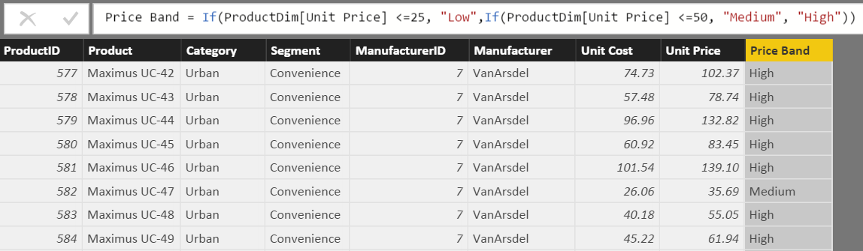
What is a Calculated Column?
DAX Foundations
Calculated Column
Pro Tip: Always refer to a calculated column by its full name -> TableName[ColumnName]
Notes:
Used to add attributes that don’t exist in the source data
See this formula. This looks a lot like Excel
Demo:
In Product Dim Table add the above formula from the Tab called “Calculated Column”

Slide 95
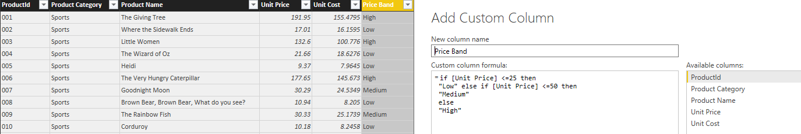
Calculated Column in DAX vs Custom Column in “Query Editor”
DAX Foundations
Note: If given a choice, creating the column in “M” or “Query Editor” will give you better compression.
Notes:
DEMO: If a question comes up related to how to create a calculated column in ”M”, then do the following:
Open Query editor and create a calculated column using this formula:
if [Unit Price] <= 25 then "Low" else if [Unit Price] <=50 then "Medium" else "High“ M is case sensitive and the if/then/else syntax is different than Excel/DAX
Instructor Talking Point, if needed:
Once the column comes in it becomes like any other column in Power BI Desktop file
The column is compressed
There is a secondary processing for Calculated Columns – Which makes process times slower

Slide 96
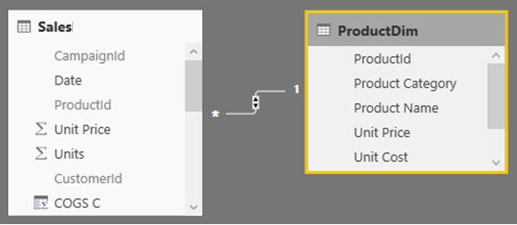
Calculated Column – Accessing columns from other Tables in model
DAX Foundations
Often you want to access columns from multiple tables to create a Calculated Columns
Let us say you want to calculate COGs, which is Units * Units Cost
Units Cost is in another Table

Slide 97
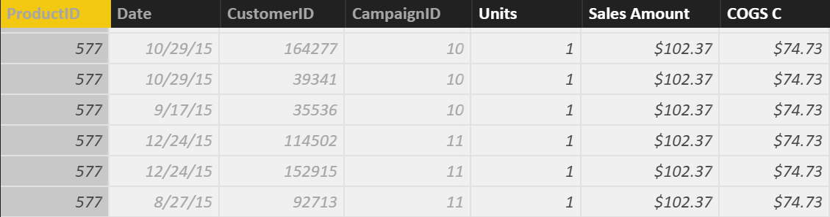
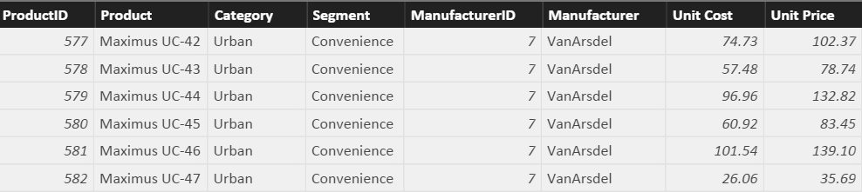
Row Context and Multiple Tables – RELATED Function
DAX Foundations
Sales[COGS] = RELATED(ProductDim[Unit Cost]) * Sales[Units]
RELATED is just like VLOOKUP in Excel
Notes:
First Bring in the column. Let it resolve and then multiply
Demo:
In SalesFact Table write this formula: Sales[COGS] = RELATED(ProductDim[Unit Cost]) * Sales[Units]
(also available in Calculated Column Tab)
Note to instructor: Just like Vlookup but without all of the drama – No NA()

Slide 98
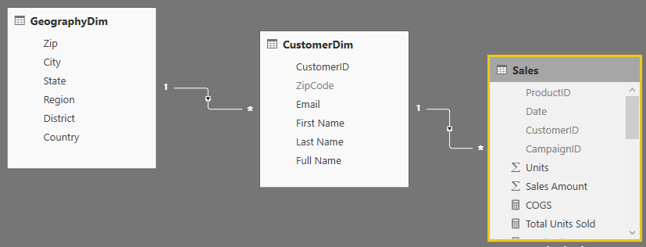
RELATED Function Example
DAX Foundations
You could follow a chain of relationship from Many side to 1 side using RELATED
Sales [City State]= RELATED(GeographyDim[City]) & “, ” & RELATED(GeographyDim[State])
Notes:
This is an example of “Just because you can, does not mean you should”
Creating a calculated column like this on the fact table takes way too much memory when it could just as easily be placed on the GeographyDim table.
No Demo on this slide
Note to Instructor: If you need to aggregate back from 1 side to the Many side, there is a companion formula called RelatedTable – but we will cover that later.

Slide 99
When is a Calculated Column Evaluated?
DAX Foundations
“Get Data” Phase
Model Creation Phase
Model
Enhancement
Phase
Visual
Building Phase
Create Query in “M”
Compress data
Auto detect relationships
Add calc. columns, Measures
Add missing relationships
Evaluate Measures and build each visual
Notes:
Note to Instructor: This has already been covered and is just reinforcing a concept covered in a previous slide.

Slide 100
Best Practices with DAX Calculated Columns
DAX Foundations
Whenever possible, DAX helper columns should be avoided. Each “Helper Column” will consume RAM
Create a calculated column in the Dim Table as opposed to in the Fact Table
Move calculated columns to “M” if you can
Notes:
Instructor Talking Point,
Best Practice is to create a calculated column at the HIGHEST level of granularity - in the highest dim

Slide 101
DAX Foundations
Calculated Column
Measure
Notes:
Instructor Note: This is just a navigation slide

Slide 102
Calculated Measures

Slide 103
Why are Default Summarizations useful?
DAX Foundations
Don’t have to know DAX
Power BI Team is looking to add easier ways to perform calculations using “Quick Measures” and “Show Value As”
Notes:
Instructor Note: Nothing to demo. Slide is self explanatory
“Quick Calcs” has been renamed to “Show Value As”
“Quick Measures” are new in the April release

Slide 104
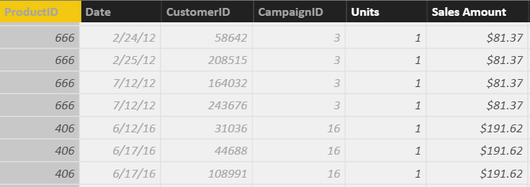
What is a Measure?
DAX Foundations
[Total Sales]=SUM(Sales[Sales Amount])
Measures are created using DAX
Place your Measures on a Fact table for best results
Pro Tip: When referring to a measure in other calculations, refer to it without a Table name: [MeasureName]
Notes:
DEMO:
From the Modeling Ribbon, show measure called Total Sales and that resolves to the same values as default summarization.
Formula: Total Sales = SUM(Sales[Sales Amount])
In the Measure tab, drop the Total Sales measure onto the graph on the right in the values section
Instructor Talking Points:
Explain the calculations in DAX vs Power BI:
On the graph on the top left, the calculations are done by Power BI implicitly.
The graph on the right, show the calculations on the right in DAX which are written, explicitly.
Instructor Note:
Talk about Home Tables. Even though it looks like Measures are in a Fact Table internally they are stored in a separate table called Measures Table
Always ensure the Home Table is a FACT table
Be sure the mention that measures should only be associated with FACT tables, and that measure names must be globally unique within the data model.
If class is interested, may be worth mentioning that the reason measure names must be unique is that they end up being associated with a hidden measures-only table that gets created in the data model

Slide 105
Measure, Use Case 1: Using One Measure in Another
DAX Foundations
Instead of writing this:
[Profit] = SUM(Sales[Sales Amount])-SUM(Sales[COGS])
Write this:
[Profit] = [Total Sales]- [Total COGS]
Allows re-use of measures
Formulas are much simpler to read
Notes:
Advantage to writing DAX
Simplify DAX by referencing other Measures
Quickly reference the list of measures from the formula bar by typing “[“ – As all Measures start with this character

Slide 106
Measure, Use Case 2: More Complex Calculations
DAX Foundations
[Profit Margin %] = [Profit] / [Total Sales]
Ratios are calculations that cannot be created using a Calculated Column or Default Summarization
Use DAX DIVIDE for built in error handling
[Profit Margin %] = DIVIDE([Profit] , [Total Sales])
Notes:
DEMO:
Profit Margin = Sales[Sales Amount] – Sales[Cogs]
Profit Margin % = DIVIDE([Profit Margin], Sum(Sales[COGS]) )

Slide 107
When is a Measure Evaluated?
DAX Foundations
“Get Data” Phase
Model Creation Phase
Model
Enhancement
Phase
Visual
Building Phase
Create Query in “M”
Compress data
auto detect relationships
Add calc. columns, Measures
Add missing relationships
Evaluate Measures and build each visual

